Slide 1
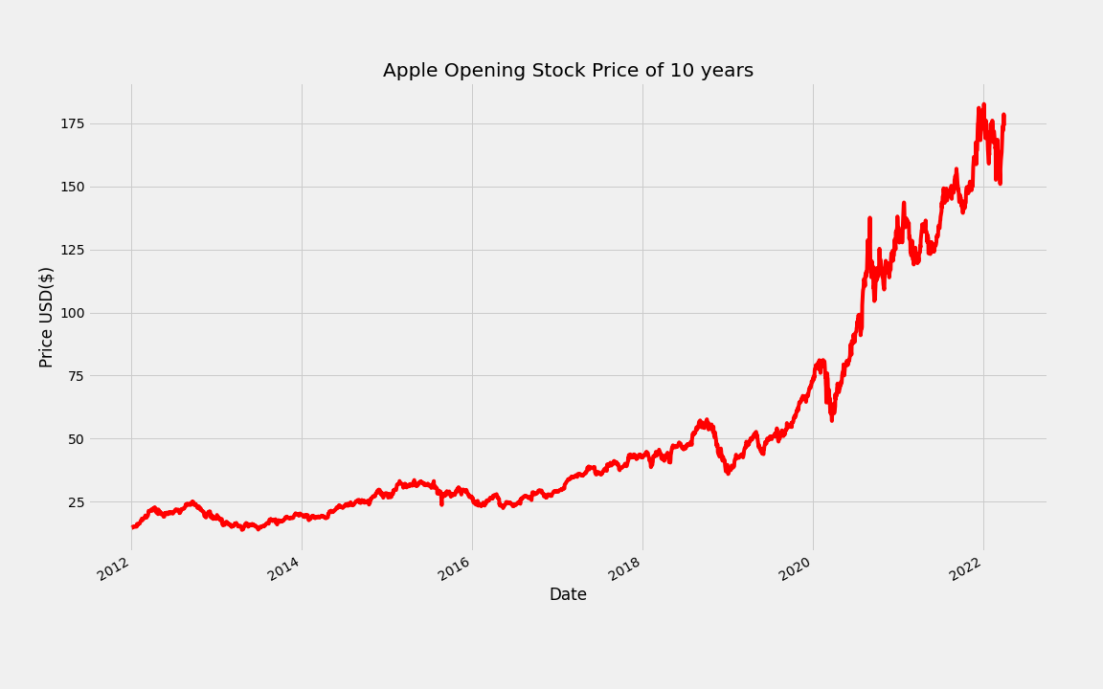
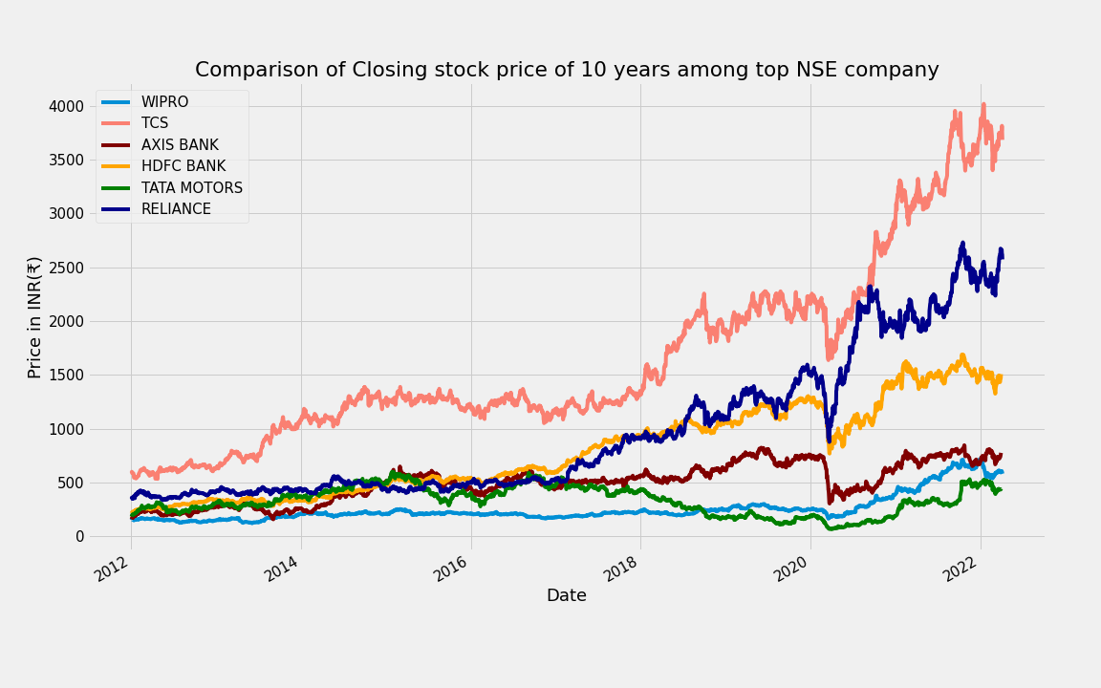
Stock Price Prediction
By
Saheb Mukherjee(11571020039)
Sayan Das (11571020040)
Under the supervision of
Mr. Abhijit Bhattacharya
Asst. Prof. Dept. of Computer Applications
B. P. Poddar Institute of Management and Technology

Slide 2
INTRODUCTION:-
A stock market is a place where people buy/sell shares or stocks of publicly listed companies
It is a widely used source for people to invest money in companies with high growth potential.
Stock market is a very risky place where it is most likely that you will face some amount of loss at a point of time.
So our aim is to minimize this risk and provide support to the investors
The paper focuses on the use of Regression technique using LSTM based Machine learning technology to predict the closing stock values.

Slide 3

OBJECTIVE:-
The main objective is to collect the streaming Data of 10 years through web scrapping technique using a python library `pandas_datareader`
The Data that would be collected will be the records of some top NSE company’s Stock Markets History of last 10 years.
Which will be then taken as a base for our exploratory data analysis (EDA).
After that the data would be cut down to 60 or 30 days for further pre-processed into 3D NumPy matrix which will make the data ready to fit in our LSTM estimator.
Then the LSTM algorithms will find patterns in the data and use regression method to predict the future ups and downs of the closing stock price of that company.

Slide 4
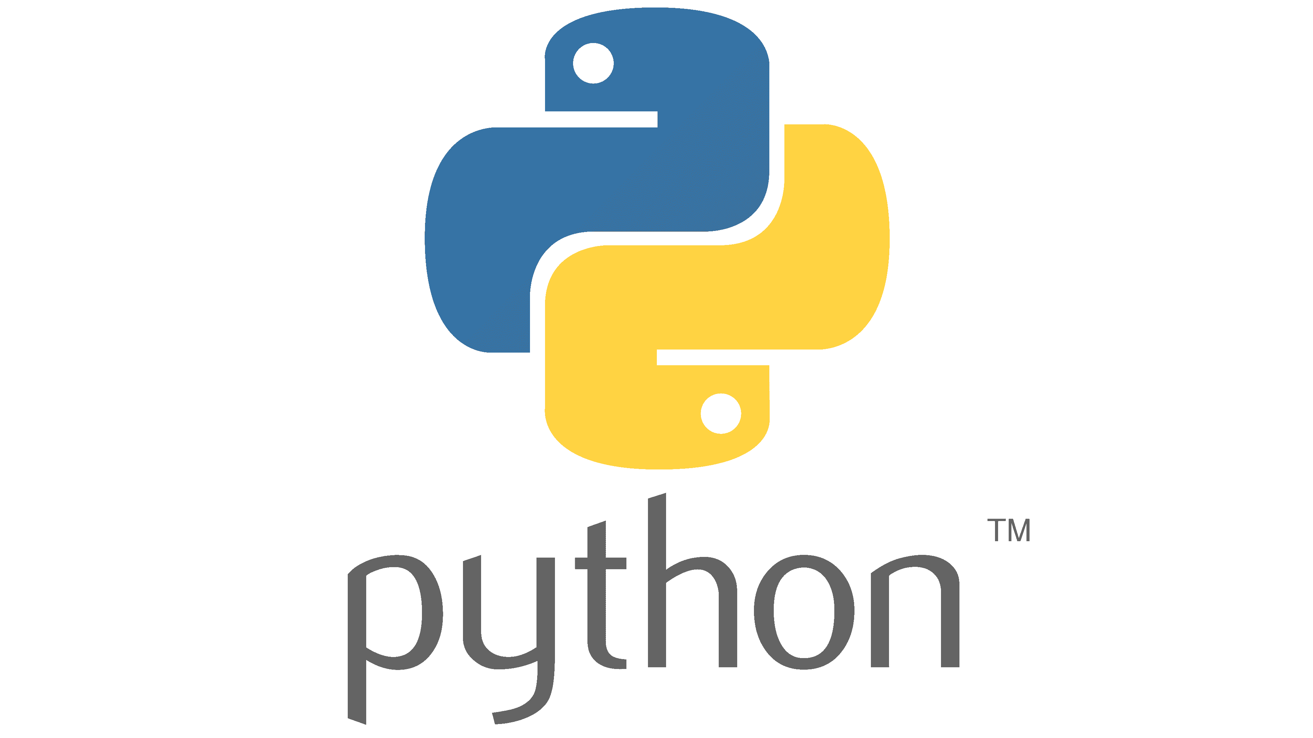


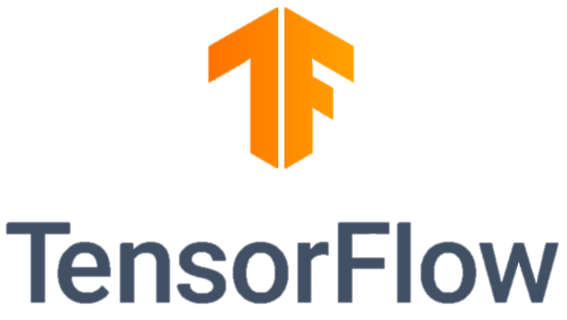


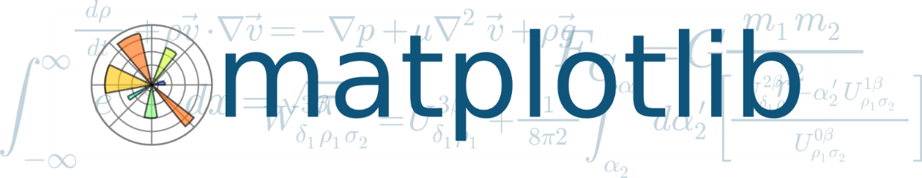

Tools Used (Software & Hardware):
Software Architecture:
python 3
Anaconda Prompt
Jupyter notebook
Scikit Learn
TensorFlow
keras
Pandas
Pandas_datareader
NumPy
Matplotlib
Seaborn
Chrome Browser
Hardware Architecture:
Processer: Intel i3
RAM: 8 GB
Hard Disk: 1 TB
Internet Connection

Slide 5

Methodology:
Here, we have choose a model called LSTM to build our Project
LSTM stands for Long Short Term Memory.
Unlike other models LSTM is special it gains the information from previous steps in a loop.
Having the previously learned information it can predict complex prediction way better than other models.
LSTM is widely used in NLP technology, but it is also going to work excellently in our problem of predicting stock price as well.

Slide 6
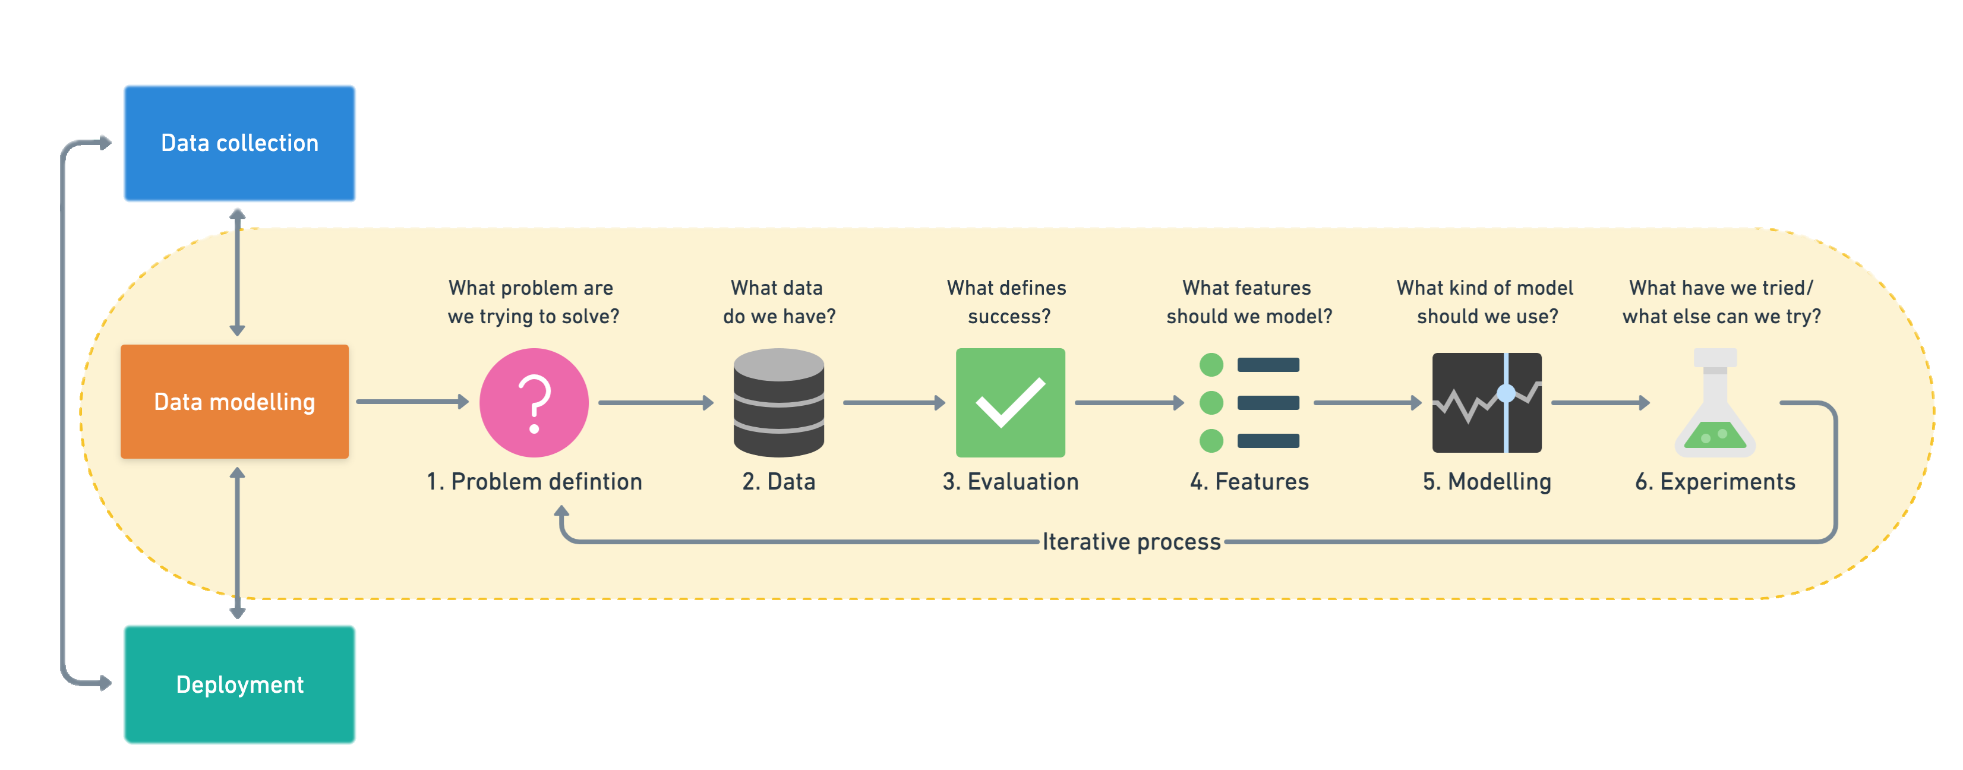
Module:-

Slide 7
Things we have done so far:-
Data Collection
Data Visualization
Data Pre-Processing
From NSE
Using Web Scrapping
Using matplotlib library
Exploratory Data Analysis on different columns
Removing Null and Redundant data
Minimizing Columns
Reshaping Data
Selecting Estimator
LSTM is our preferred estimator
If needed we will look on some other algorithms as well

Slide 8
Exploratory Data Analysis(EDA)
Simple Data Visualization
Comparison of Closing data of different company
High vs Low trade analysis
Volume Trade visualization
Last quarter closing summary, etc.

Slide 9
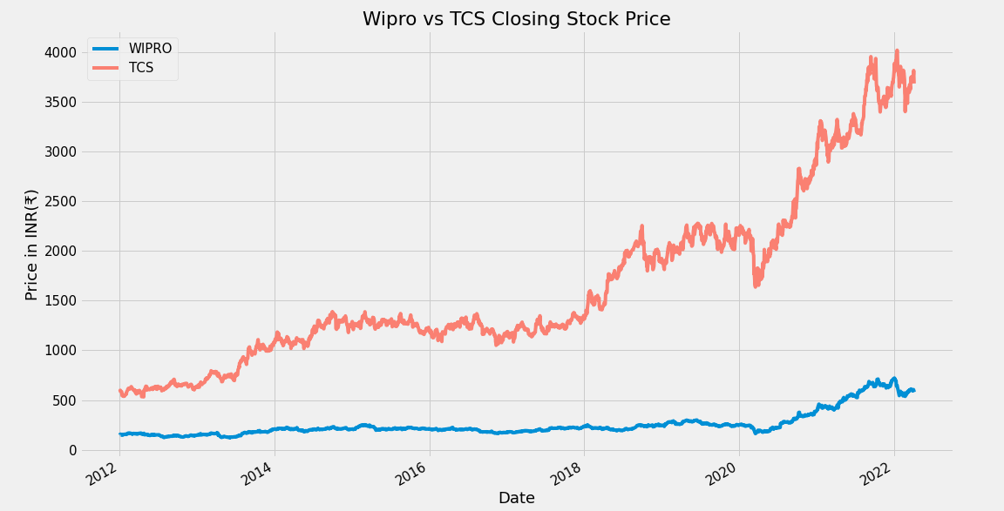
Wipro Highest Closing is 721.5 on 04-01-2022 vs TCS Highest Closing is 4019.15 on 17-01-2022

Slide 10
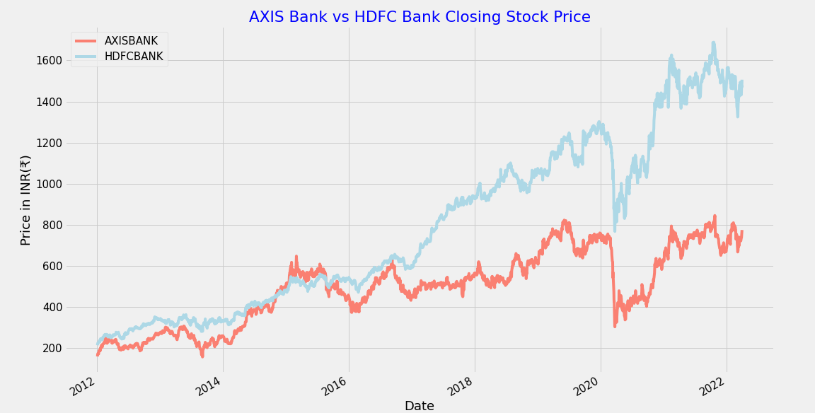
AXIS Bank Highest Closing is 845.09 on 25-10-2021 vs HDFC Bank Highest Closing is 2731.85 on 19-10-2021

Slide 11
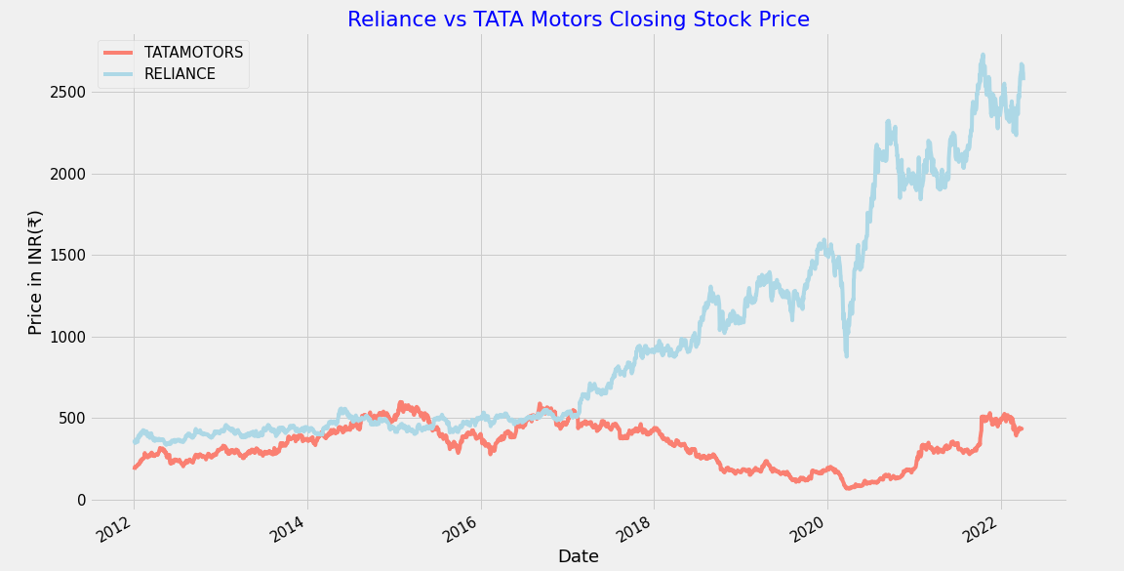
TATA Motors Highest Closing is 598.13 on 27-01-2015 vs Reliance Highest Closing is 2731.85 on 19-10-2021

Slide 12
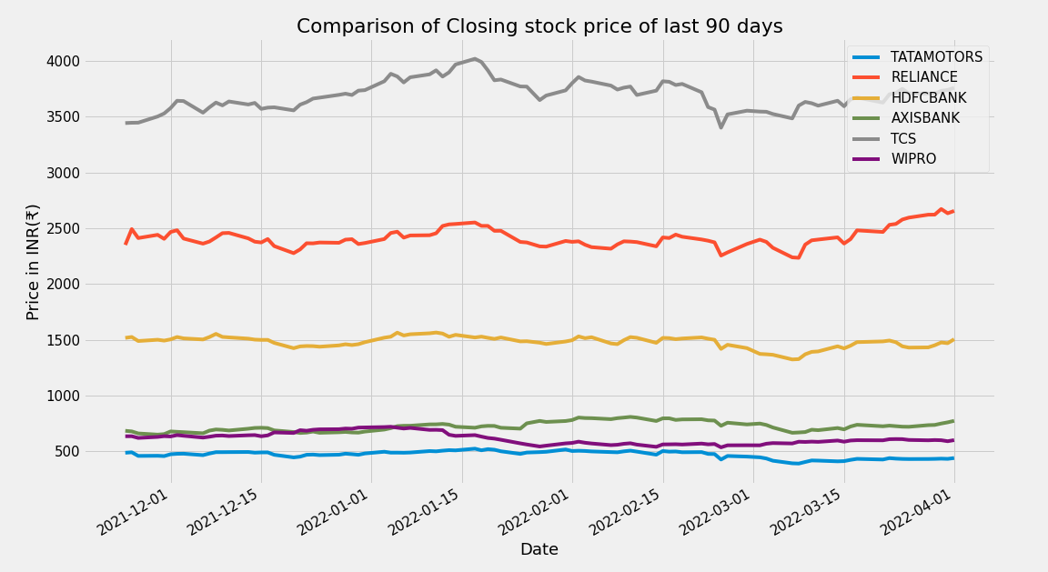
Last Quarter Performance Comparison of Top NSE Companies by Evaluating the Closing Stock Price

Slide 13
Things still left to be done:-
Model Training
Model Evaluation
Hyper-Parameter Tuning
Experimenting
Project Deployment
Will train our LSTM model
We will evaluating our model to see if its predictions are accurate or not
This is a process which might not be necessary unless
The model performs very low
Experimenting with different situations
When the project will ready
We will deploy it google collaboratory

Slide 14
Expected Outcome:
The expected outcome of this project is to develop a system which will help us to predict the stock market future 60 day’s outcome.
Also predict the stock assurance and predict the names where we can invest our stock price or not.

Slide 15
References:
YouTube/KrishNaik
YouTube/codebasic
SK-Learn Documentation
Tensorflow Documentation
Stackoverflow.com
Udemy
Wikepedia

Slide 16

THANK YOU
For Your Valuable Time
&
Special Thanks To A.B Sir

